Slide 1

Noida Institute of Engineering and Technology, Greater Noida
Advanced Java Programming(ACSE0601)
Unit: 4
Ms. Teena
Assistant Professor
CSE Department
Spring MVC & Spring Boot
Course Details (B Tech VI Sem / 3rd Year)

Slide 2
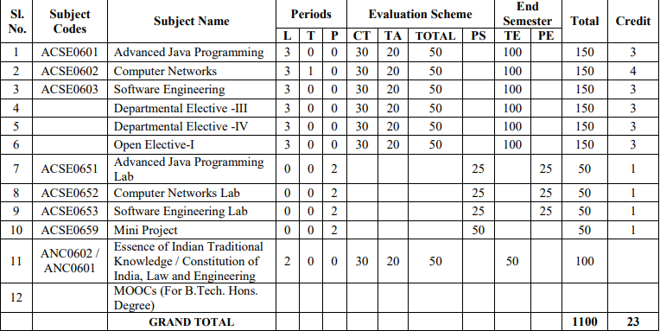
Evaluation Scheme

Slide 3
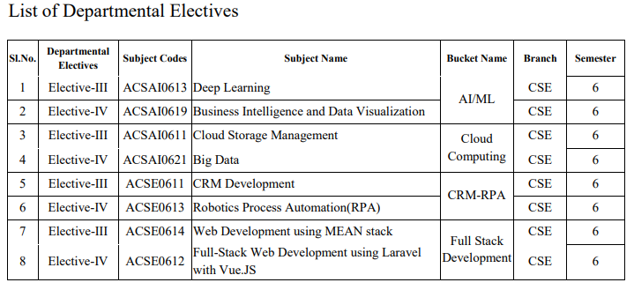
Evaluation Scheme

Slide 4
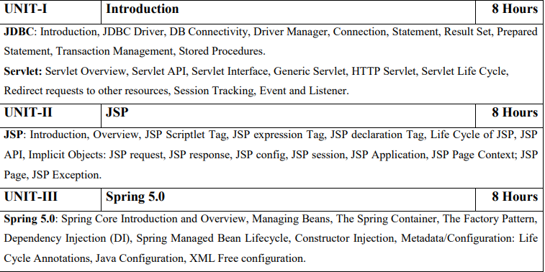
Syllabus

Slide 5
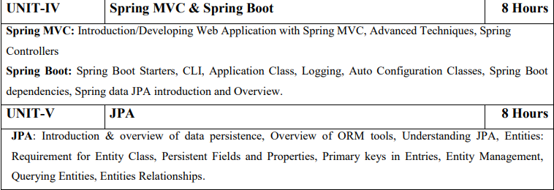
Syllabus

Slide 6
Branch-wise Applications
Advanced Java can be used :
Design/Develop Program
Develop appropriate data model and database scheme
Create and test prototypes
Develop Structure
Identify major subsystems and interfaces
Validate design scheme and models
Implement Program
Write code
Perform unit testing
Integrate subsystems
Resolve defects and revise and adapt existing code
Perform Analysis
Define system and software requirements
Develop test requirements
Test and Validate the Program
Develop test procedures
Perform tests

Slide 7
Course Objectives
Develop error-free, well-documented Java programs; develop and test Java network, search engine, and web framework programs. Learn how to write, test, and debug advanced-level Object-Oriented programs using Java. Develop error-free, well-documented Java programs; develop and test Java network, search engine, and web framework programs. Learn how to write, test, and debug error-free, well-documented Java programs; develop and test Java network, search engine, and web framework programs. Learn how to write, test, and debug advanced-level Object-Oriented programs using Object-Oriented programs using Java.
Develop error-free, well-documented Java programs; develop and test Java network, search engine, and web framework programs. Learn how to write, test, and debug advanced-level Object-Oriented programs using Java.
to provide the ability to design console based, GUI based ,web based applications, integrated development environment to create, debug and run multi-tier and enterprise-level application

Slide 8
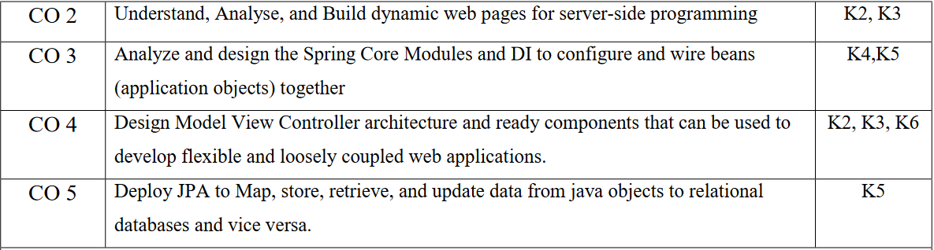
Course Outcomes
After completion of this course students will be able to:

Slide 9
Program Outcomes
After completion of this course students will be able to:
PO1 | To understand the concept of web application and latest frameworks of Java.
PO2 | To demonstrate the Java programs using OOP principles and also implement the concepts of Spring and Spring Boot.
PO3 | To demonstrate, understand and use of different concept of MVC, JDBC, Spring etc.
PO4 | To solve the real time problems using using advance concept of Java.
PO5 | To understand the JPA and entities relationship.

Slide 10
CO-PO Mapping
Mapping of Course Outcomes and Program Outcomes:
 | PO1 | PO2 | PO3 | PO4 | PO5 | PO6 | PO7 | PO8 | PO9 | PO10 | PO11 | PO12
CO.1 | 3 | 3 | 3 | 2 | 1 |  |  |  | 2 |  |  | 3
CO.2 | 3 | 3 | 3 | 2 | 1 |  |  |  | 2 |  |  | 3
CO.3 | 3 | 3 | 3 | 2 | 1 |  |  |  | 2 |  |  | 3
CO.4 | 3 | 3 | 3 | 2 | 1 |  |  |  | 2 |  |  | 3
CO.5 | 3 | 3 | 3 | 2 | 1 |  |  |  | 2 |  |  | 3

Slide 11
Program Specific Outcomes
On successful completion of graduation degree the Engineering
graduates will be able to:
PSO1: The ability to identify, analyze real world problems and design
their ethical solutions using artificial intelligence, robotics,
virtual/augmented reality, data analytics, block chain technology,
and cloud computing.
PSO2:The ability to design and develop the hardware sensor devices
and related interfacing software systems for solving complex
engineering problems.
PSO3:The ability to understand inter disciplinary computing
techniques and to apply them in the design of advanced
computing.
PSO4: The ability to conduct investigation of complex problem with
the help of technical, managerial, leadership qualities, and
modern engineering tools provided by industry sponsored
laboratories.

Slide 12
CO-PSO Mapping
Mapping of Course Outcomes and Program Specific Outcomes:
 | PSO1 | PSO2 | PSO3 | PSO4
Co.1 | 2 | 3 | 2 | 1
CO.2 | 2 | 3 | 2 | 1
CO.3 | 2 | 3 | 2 | 1
CO.4 | 2 | 3 | 2 | 1
CO.5 | 2 | 3 | 2 | 1

Slide 13
Program Educational Objectives
PEO1: To have an excellent scientific and engineering breadth so as
to comprehend, analyze, design and provide sustainable
solutions for real-life problems using state-of-the-art
technologies.
PEO2:To have a successful career in industries, to pursue higher
studies or to support enterpreneurial endeavors and to face
global challenges.
PEO3:To have an effective communication skills, professional
attitude, ethical values and a desire to learn specific
knowledge in emerging trends, technologies for research,
innovation and product development and contribution to
society.
PEO4: To have life-long learning for up-skilling and re-skilling for
successful professional career as engineer, scientist,
enterpreneur and bureaucrat for betterment of society.

Slide 14
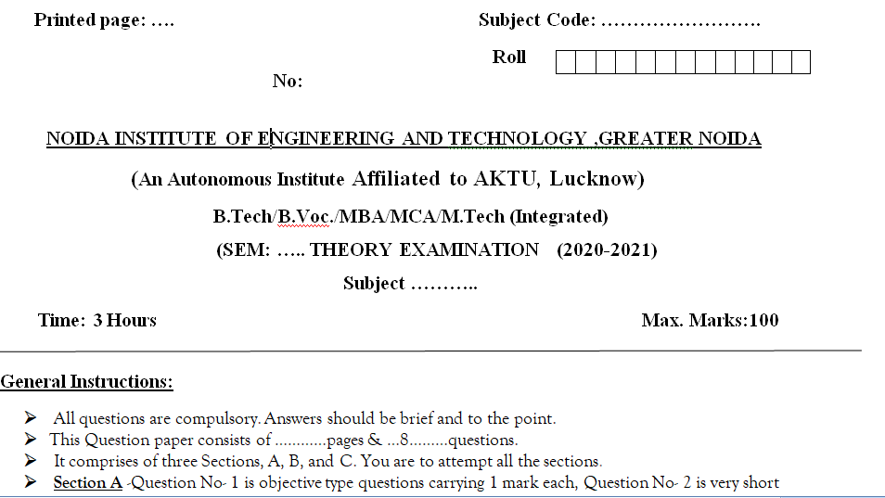
End Semester Question Paper Templates (Offline Pattern/Online Pattern

Slide 15
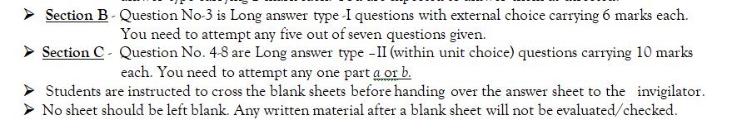
End Semester Question Paper Templates (Offline Pattern/Online Pattern

Slide 16

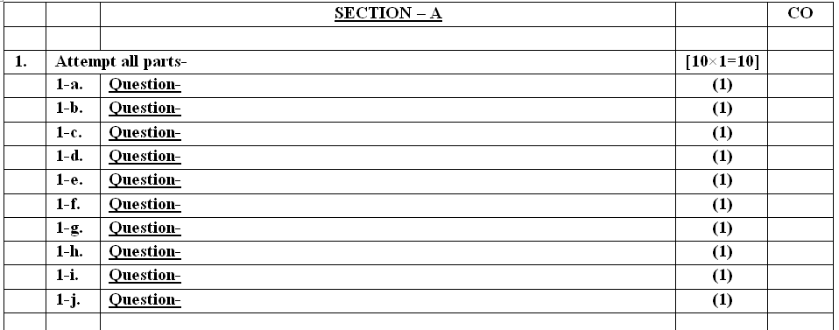
End Semester Question Paper Templates (Offline Pattern/Online Pattern

Slide 17
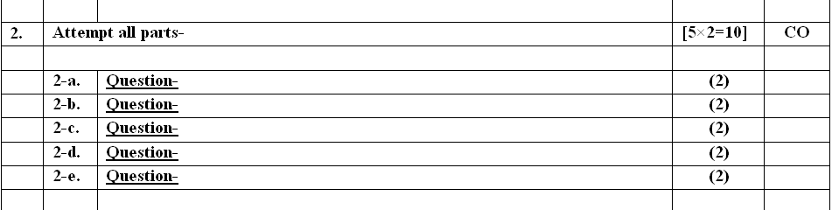
End Semester Question Paper Templates (Offline Pattern/Online Pattern

Slide 18
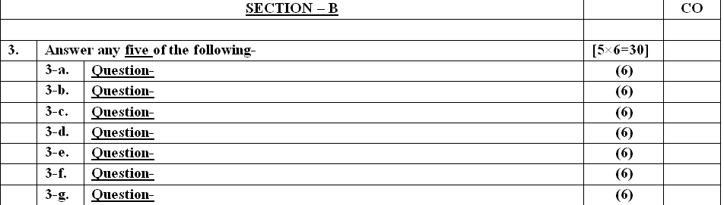
End Semester Question Paper Templates (Offline Pattern/Online Pattern

Slide 19
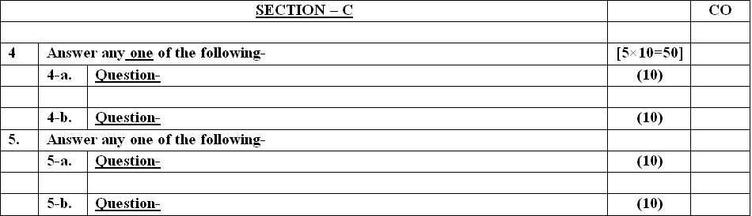
End Semester Question Paper Templates (Offline Pattern/Online Pattern

Slide 20
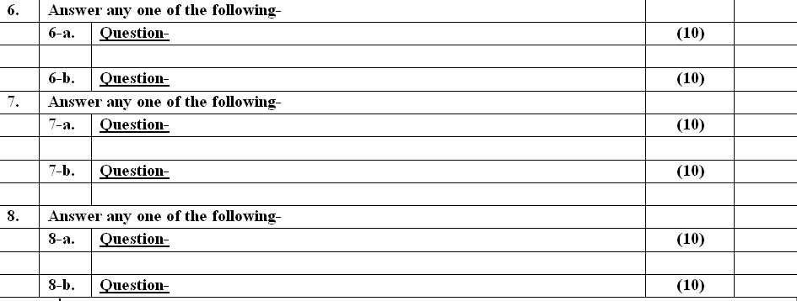
End Semester Question Paper Templates (Offline Pattern/Online Pattern

Slide 21
Prerequisite and Recap
Student must know at least the basics of Java programming ,able to start coding on any IDE.
Knowledge of object oriented techniques using Java concepts, as covered in ‘Programming Basic” course is necessary.

Slide 22
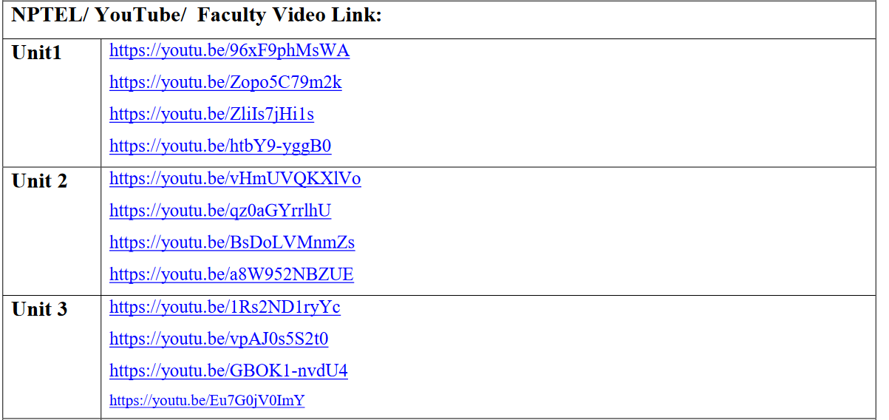
About the Subject with Videos
Advanced Java Programming refers to languages that uses objects in programming.
Advanced Java Programming aims to implement real-world entities like inheritance, hiding, polymorphism etc in programming.
The main aim of Advanced Java Programming is to bind together the data and the functions that operate on them so that no other part of the code can access this data except that function

Slide 23
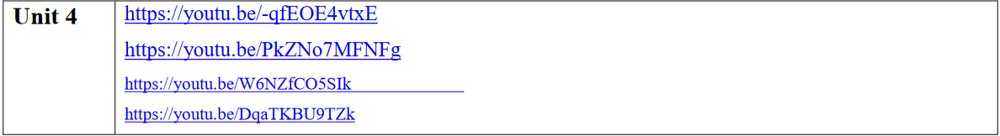
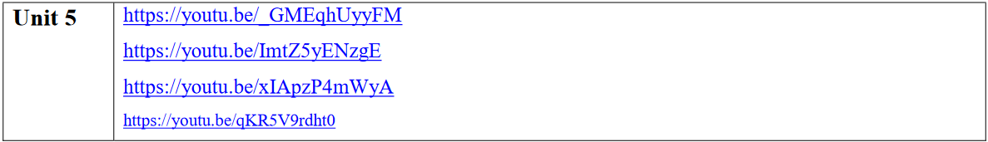
About the Subject with Videos

Slide 24
UNIT OBJECTIVE
This course gives the fundamental knowledge of Spring Model View Controller and Spring Boots
The unit will help the students to understand how the approaches of threads help in solving real life problems.
Basic understanding of Java Framework like Spring and Spring Boots used.
Overview of creating custom annotations and using them in programs.

Slide 25
UNIT CONTENT
Spring MVC
Introduction/Developing Web Application with Spring MVC
Advanced Techniques
Spring Controllers
Spring Boot
Spring Boot Starters
CLI
Application Class
Logging
Auto Configuration Classes
Spring Boot Dependencies
Spring data JPA introduction and Overview

Slide 26
Spring MVC: Introduction
Spring MVC framework is an open-source Java platform that provides comprehensive infrastructure support for developing robust Java-based Web applications very easily and very rapidly.
Spring framework was initially written by Rod Johnson and was first released under the Apache 2.0 license in June 2003.
It follows the Model-View-Controller design pattern. It implements all the basic features of a core spring framework like Inversion of Control, and Dependency Injection.
A Spring MVC provides an elegant solution to use MVC in spring framework with the help of DispatcherServlet.
DispatcherServlet is a class that receives the incoming request and maps it to the right resource such as controllers, models, and views.

Slide 27
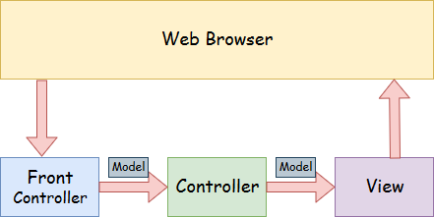
Spring Web Model-View-Controller
(MVC)

Slide 28
MVC
Model - A model contains the data of the application. A data can be a single object or a collection of objects. The Model encapsulates the application data and in general, they will consist of POJO.
View - A view represents the provided information in a particular format. Generally, JSP+JSTL is used to create a view page. Although spring also supports other view technologies such as Apache Velocity, Thymeleaf and FreeMarker. The View is responsible for rendering the model data and in general, it generates HTML output that the client's browser can interpret.
Controller - A controller contains the business logic of an application. Here, the @Controller annotation is used to mark the class as the controller. The Controller is responsible for processing User Requests and Building Appropriate Model and passes it to the view for rendering.
Front Controller - In Spring Web MVC, the DispatcherServlet class works as the front controller. It is responsible to manage the flow of the Spring MVC application.

Slide 29
Working of MVC Framework
Spring MVC Framework works as follows:
All the incoming requests are intercepted by the DispatcherServlet that works as the front controller.
The DispatcherServlet then gets an entry of handler mapping from the XML file and forwards the request to the controller.
The object of ModelAndView is returned by the controller.
The DispatcherServlet checks the entry of the view resolver in the XML file and invokes the appropriate view component.

Slide 30
Daily Quiz - MCQ
1. What does MVC stand for in Spring MVC?
a) Multi-View Controller
b) Module-View-Controller
c) Model-View-Controller
d) Model-Value-Configuration
Answer:
c) Model-View-Controller
Explanation:
MVC stands for Model-View-Controller, which is a design pattern to separate an application's concerns.

Slide 31
Daily Quiz - MCQ
2. What is Spring MVC
a) A programming language for web development.
b) A lightweight Java framework for building web applications.
c) A database management system for web applications.
d) A library for handling server-side rendering.
Answer:
b) A lightweight Java framework for building web applications.
Explanation:
Spring MVC is a lightweight Java framework built on top of the Spring Framework. It provides a flexible architecture for developing web applications based on the Model-View-Controller design pattern. Spring MVC simplifies web development by providing features such as request handling, view rendering, and data binding.

Slide 32
Daily Quiz - MCQ
3. Which annotation is used to create a Spring MVC controller class?
a) @Controller Bean
b) @Spring Controller
c) @Web Controller
d) @Controller
Answer:
d) @Controller
Explanation:
The @Controller annotation indicates that a class is a Spring MVC controller.

Slide 33
Daily Quiz - MCQ
4. Which of the following handles the HTTP request in Spring MVC?
a) Dispatcher Servlet
b) Handler Interceptor
c) Http Listener
d) Request Handler
Answer:
a) Dispatcher Servlet
Explanation:
In Spring MVC, the Dispatcher Servlet is responsible for dispatching incoming HTTP requests to the appropriate controller methods.

Slide 34
Daily Quiz - MCQ
5. Which annotation binds a method parameter to a named attribute?
a) @Model Attribute
b) @Parameter Attribute
c) @Bind Attribute
d) @Request Value
Answer:
a) @Model Attribute
Explanation:
The @Model Attribute annotation is used to bind a method parameter to a named attribute, potentially initializing the attribute from a database or other source.

Slide 35
Advantages of Spring MVC Framework
The container is used for the development and deployment of applications and uses a lightweight servlet.
It enables rapid and parallel development.
Development of the application becomes fast.
Easy for multiple developers to work together.
Easier to Update the application.
It is Easier to Debug because we have multiple levels in the application.

Slide 36
Disadvantages of Spring MVC Framework
It has high complexity to develop the applications using this pattern.
It is not suitable for small applications which affect the application’s performance and design.

Slide 37
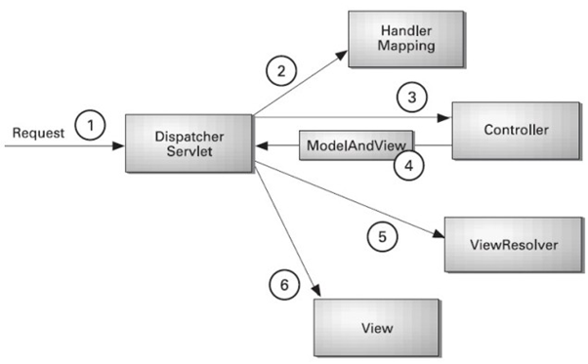
Understanding the flow of Spring Web MVC

Slide 38
Cont…
As displayed in the figure, all the incoming request is intercepted by the DispatcherServlet that works as the front controller.
The DispatcherServlet gets an entry of handler mapping from the XML file and forwards the request to the controller.
The controller returns an object of ModelAndView.
The DispatcherServlet checks the entry of view resolver in the XML file and invokes the specified view component.

Slide 39
Daily Quiz - MCQ
6. How can you handle exceptions in Spring MVC?
a) @Exception Handler
b) @Catch Exception
c) @Error Resolver
d) @Resolve Error
Answer:
a) @Exception Handler
Explanation:
The @Exception Handler annotation is used to handle exceptions in Spring MVC.

Slide 40
Daily Quiz - MCQ
7. What is the purpose of the Model And View object in Spring MVC?
a) To store and pass data between the controller and the view.
b) To define the layout and styling of the web application.
c) To handle user authentication and authorization.
d) To manage the application's data access layer.
Answer:
a) To store and pass data between the controller and the view.
Explanation:
The Model And View object in Spring MVC is used to store and pass data between the controller and the view. It combines both the model and view aspects, allowing the controller to add data to the model and specify the view that should be rendered. The Model And View object serves as a container for carrying data and view information during request processing in Spring MVC.

Slide 41
Daily Quiz - MCQ
8. Which annotation is used to bind a method parameter to a web request header?
a) @Request Header
b) @Header
c) @Bind Header
d) @HTTP Header
Answer:
a) @Request Header
Explanation:
The @Request Header annotation is used to bind a method parameter to a specific web request header.

Slide 42
Daily Quiz - MCQ
9. How can you access request parameters in a Spring MVC controller method?
a) By using the @Request Param annotation.
b) By accessing them directly from the Http Servlet Request object.
c) By using the @Path Variable annotation.
d) By using the @Request Header annotation.
Answer:
a) By using the @Request Param annotation.
Explanation:
In a Spring MVC controller method, you can access request parameters by using the @Request Param annotation. This annotation binds a request parameter value to a method parameter, making it easy to retrieve and process the parameter value in the controller.

Slide 43
Daily Quiz - MCQ
10. In Spring MVC, what is the role of the View Resolver?
a) Resolving bean dependencies
b) Handling exceptions
c) Resolving views to specific URLs
d) Handling request parameters
Answer:
c) Resolving views to specific URLs
Explanation:
View Resolver in Spring MVC helps in mapping view names to actual views (like JSPs).

Slide 44
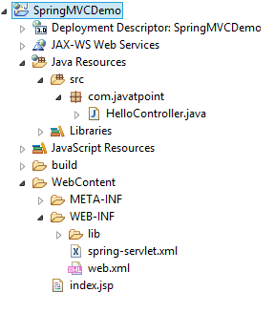
Directory Structure of Spring MVC

Slide 45
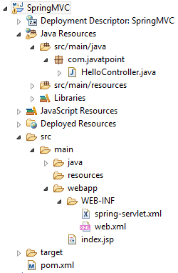
Directory Structure of Spring MVC using Maven

Slide 46
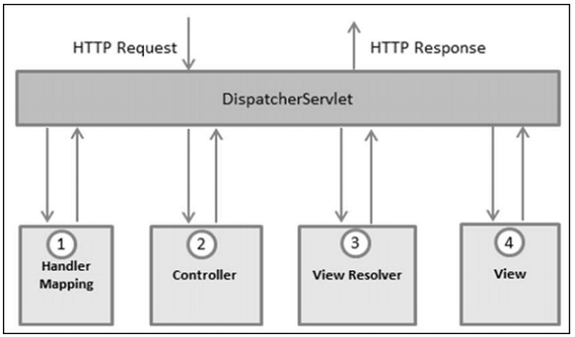
The Dispatcher Servlet
The Spring Web model-view-controller (MVC) framework is designed around a DispatcherServlet that handles all the HTTP requests and responses. The request processing workflow of the Spring Web MVC DispatcherServlet is shown in the following illustration.

Slide 47
Daily Quiz - MCQ
11. Which annotation is used to denote a regular expression in URI template in Spring MVC?
a) @Regex
b) @Path Variable
c) @URI Expression
d) @Match Pattern
\
Answer:
b) @Path Variable
Explanation:
The @Path Variable annotation can be used to extract values from the URI, and it supports regular expressions.

Slide 48
Daily Quiz - MCQ
12. Which Spring MVC module provides integration with RESTful services?
a) Spring Rest Controller
b) Spring REST
c) Spring Web MVC
d) Spring Web Flux
Answer:
c) Spring Web MVC
Explanation:
While @Rest Controller is an annotation used to create REST ful controllers, it's the Spring Web MVC module that provides integration with REST ful services.

Slide 49
Daily Quiz - MCQ
13. Which annotation indicates a method should handle HTTP POST requests?
a) @Http Post
b) @Post Handler
c)@Request Mapping (method = Request Method.POST)
d) @Post Mapping
Answer:
d) @Post Mapping
Explanation:
The @Post Mapping is a composed annotation that acts as a shortcut for @Request Mapping(method = Request Method.POST).

Slide 50
Daily Quiz - MCQ
14. What does the @Response Body annotation do?
a) It sends the return value of a method back to the web response body.
b) It binds the parameters of a method to the request body.
c) It triggers an exception handling method.
d) It binds the result of a method to a view.
Answer:
a) It sends the return value of a method back to the web response body.
Explanation:
The @Response Body annotation tells a controller that the return value of a method should be written directly to the HTTP response body.

Slide 51
Daily Quiz - MCQ
15. How do you redirect to another URL in Spring MVC?
a) "redirect:/url_path"
b) "forward:/url_path"
c) "goto:/url_path"
d) "move:/url_path"
Answer:
a) "redirect:/url_path"
Explanation:
In Spring MVC, to perform a redirect, you return a string starting with "redirect:" followed by the path.

Slide 52
Create Your First Spring MVC Application
Step 3: Provide the name of the controller in the web.xml file as follows:
DispatcherServlet is the front controller in Spring Web MVC. Incoming requests for the HTML file are forwarded to the DispatcherServlet.
Step 4: We have to define the bean in a separate XML file. We have specified the view components in this file. It is located in the WEB-INF directory.
Step 5: Use JSP to display the message.
Step 6: Start the server and run the project.
Step 0: Setup your project with maven use the required archetype to get the required folders directory and configure the server with your project.
Step 2: Create the Controller Class.

Slide 53
Spring Boot
Spring Boot provides a number of starters that allow us to add jars in the classpath. Spring Boot built-in starters make development easier and rapid. Spring Boot Starters are the dependency descriptors.
In the Spring Boot Framework, all the starters follow a similar naming pattern: spring-boot-starter-*, where * denotes a particular type of application. For example, if we want to use Spring and JPA for database access, we need to include the spring-boot-starter-data-jpa dependency in our pom.xml file of the project.

Slide 54
What is Spring Boot
Spring Boot is a project that is built on the top of the Spring Framework. It provides an easier and faster way to set up, configure, and run both simple and web-based applications.

Slide 55
It is a Spring module that provides the RAD (Rapid Application Development) feature to the Spring Framework. It is used to create a stand-alone Spring-based application that you can just run because it needs minimal Spring configuration.
In short, Spring Boot is the combination of Spring Framework and Embedded Servers.
In Spring Boot, there is no requirement for XML configuration (deployment descriptor). It uses convention over configuration software design paradigm that means it decreases the effort of the developer.
We can use Spring STS IDE or Spring Initializr to develop Spring Boot Java applications.

Slide 56
Difference b/w Spring MVC & Spring Boot
S.No. | SPRING MVC | SPRING BOOT
1. | Spring MVC is a Model View, and Controller based web framework widely used to develop web applications. | Spring Boot is built on top of the conventional spring framework, widely used to develop REST APIs.
2. | If we are using Spring MVC, we need to build the configuration manually. | If we are using Spring Boot, there is no need to build the configuration manually.
3. | In the Spring MVC, a deployment descriptor is required. | In the Spring Boot, there is no need for a deployment descriptor.
4. | Spring MVC specifies each dependency separately. | It wraps the dependencies together in a single unit.
5. | Spring MVC framework consists of four components : Model, View, Controller, and Front Controller. | There are four main layers in Spring Boot: Presentation Layer, Data Access Layer, Service Layer, and Integration Layer.
6. | It takes more time in development. | It reduces development time and increases productivity.
7. | Spring MVC do not provide powerful batch processing. | Powerful batch processing is provided by Spring Boot.
8. | Ready to use feature are provided by it for building web applications. | Default configurations are provided by it for building a Spring powered framework.

Slide 57
Daily Quiz - MCQ
16. Which of the following annotations is used to handle multipart file uploads?
a) @File Upload
b) @Multipart File
c) @Request File
d) @Upload Part
Answer:
b) @Multipart File
Explanation:
The @Multipart File annotation is used to handle multipart file uploads in Spring MVC.

Slide 58
Daily Quiz - MCQ
17. How do you specify that a controller method should produce JSON as a response?
a) @Produces("application/json")
b) @ResponseBody(type="json")
c) @ResponseFormat("JSON")
d) @RequestMapping(produces="application/json")
Answer:
d) @RequestMapping(produces="application/json")
Explanation:
The @RequestMapping annotation with the produces attribute set to "application/json" specifies that the controller method should produce JSON as a response.

Slide 59
Daily Quiz - MCQ
18. Which of the following represents a form-backing bean in Spring MVC?
a) @FormEntity
b) @ModelEntity
c) @ModelAttribute
d) @BeanForm
Answer:
c) @ModelAttribute
Explanation:
@ModelAttribute can be used to represent a form-backing bean in Spring MVC.

Slide 60
Daily Quiz - MCQ
19. Which of the following components decides which controller method is to be called for a request?
a) Dispatcher Servlet
b) Controller
c) Handler Mapping
d) View Resolver
Answer:
c) Handler Mapping
Explanation:
The Handler Mapping component decides which controller method should be called based on the incoming request.

Slide 61
Daily Quiz - MCQ
20. What does the @Valid annotation in Spring MVC do?
a) It ensures that the method is correctly overridden from a superclass.
b) It triggers validation of a method parameter or field.
c) It ensures that an HTTP request is valid.
d) It validates the return type of a method.
Answer:
b) It triggers validation of a method parameter or field.
Explanation:
The @Valid annotation triggers validation of the annotated method parameter or field.

Slide 62
Spring Boot CLI
The Spring Boot CLI (Command-Line Interface) can be installed manually by using SDKMAN! (the SDK Manager) or by using Homebrew or MacPorts if you are an OSX user.

Slide 63
Daily Quiz-MCQ
Q21. Spring Boot is used for developing?
1. Web applications
2. Distributed applications (Restful web services)
3. Microservices
4. All of the above
Answer:
4. All of the above
Explanation:
Spring boot is used to build Web applications, REST APIs, and Microservices.

Slide 64
Daily Quiz-MCQ
Q22. What is Spring Initializer?
1. Web-based tool to bootstrap Spring projects and generate project skeletons with the necessary configurations and dependencies.
2. A command-line tool for generating a basic Spring Boot project structure
3. A tool for initializing a Spring-based application with a specific set of dependencies
4. A tool for creating a Spring Boot application with a specific set of features
Answer:
1. Web-based tool to bootstrap Spring projects and generate project skeletons with the necessary configurations and dependencies.
Explanation:
Spring Initializr is a web-based tool provided by the Spring team to bootstrap Spring projects and generate project skeletons with the necessary configurations and dependencies. It simplifies the process of creating a new Spring-based application by providing an intuitive user interface to customize and generate project structures.

Slide 65
Daily Quiz-MCQ
Q23. What does Spring Boot do to simplify the configuration of a Spring-based application?
1. Automatically configures necessary beans and dependencies
2. Uses annotations to configure beans and dependencies
3. Allows for the use of XML configuration files
4. Provides a command line interface for configuring the application
Answer:
1. Automatically configures necessary beans and dependencies
Explanation:
Spring Boot's auto-configuration feature automatically configures the application based on the classpath dependencies and predefined conventions. It scans the classpath for libraries and frameworks and configures the application accordingly, reducing the need for manual configuration.

Slide 66
Daily Quiz-MCQ
Q24. How can a Spring Boot application be packaged and distributed?
1. As a JAR file
2. As a WAR file
3. As a ZIP file
4. All of the above
Answer:
4. All of the above
Explanation:
Spring Boot application can be distributed as JAR, WAR, and Zip files.

Slide 67
Daily Quiz-MCQ
Q25. Which Spring annotation is used to create RESTful web services using Spring MVC?
1. @RestController
2. @Controller
3. @Component
4. @Rest
Answer:
1. @RestController
Explanation:
When you annotate a class with @RestController, it indicates that the class is a Spring MVC REST controller responsible for handling incoming HTTP requests and generating the appropriate HTTP responses.

Slide 68
Daily Quiz-MCQ
Q26. @RestController annotation is a combination of the below two annotations
1. @Component and @ResponseBody annotations
2. @Controller and @ResponseBody annotations
3. @Service and @ResponseBody annotations
4. None of the above
Answer:
2. @Controller and @ResponseBody annotations
Explanation:
@RestController combines the functionality of the @Controller and @ResponseBody annotations into a single annotation, making it convenient for creating RESTful APIs.

Slide 69
Daily Quiz-MCQ
Q27. Which Spring annotation is used to handle HTTP POST requests?
1. @GetMapping
2. @PutMapping
3. @CreateMapping
4. @PostMapping
Answer:
4. @PostMapping
Explanation:
The @PostMapping annotation is used to map an HTTP POST request to a specific handler method in a Spring MVC controller. It is a shortcut for specifying the @RequestMapping annotation with the RequestMethod.POST method.

Slide 70
Spring Boot Architecture
Spring Boot is a module of the Spring Framework. It is used to create stand-alone, production-grade Spring Based Applications with minimum efforts. It is developed on top of the core Spring Framework.
Spring Boot follows a layered architecture in which each layer communicates with the layer directly below or above (hierarchical structure) it.
Before understanding the Spring Boot Architecture, we must know the different layers and classes present in it. There are four layers in Spring Boot are as follows:
Presentation Layer
Business Layer
Persistence Layer
Database Layer

Slide 71
Creating a Spring Boot Project
Following are the steps to create a simple Spring Boot Project.
Step 1: Open the Spring initializr https://start.spring.io.
Step 2: Provide the Group and Artifact name. We have provided Group name com.javatpoint and Artifact spring-boot-example.
Step 3: Now click on the Generate button.

Slide 72
Creating a Spring Boot Project
Following are the steps to create a simple Spring Boot Project.
Step 1: Open the Spring initializr https://start.spring.io.
Step 2: Provide the Group and Artifact name. We have provided Group name com.javatpoint and Artifact spring-boot-example.
Step 3: Now click on the Generate button.

Slide 73
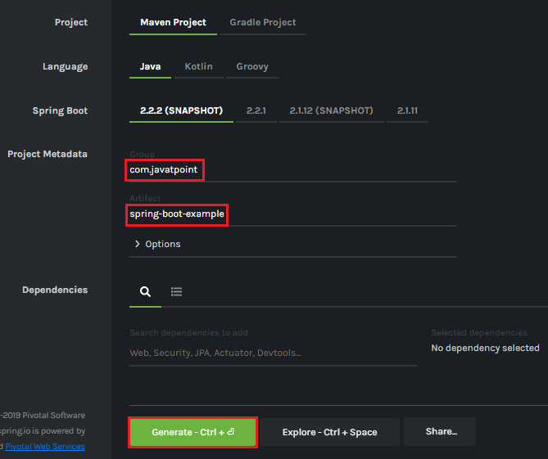
Cont…

Slide 74
Cont…
When we click on the Generate button, it starts packing the project in a .rar file and downloads the project.
Step 4: Extract the RAR file.
Step 5: Import the folder.
File -> Import -> Existing Maven Project -> Next -> Browse -> Select the project -> Finish
It takes some time to import the project. When the project imports successfully, we can see the project directory in the Package Explorer. The following image shows the project directory:

Slide 75
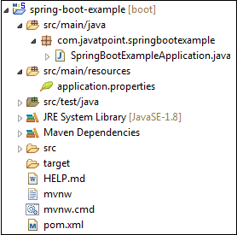
Cont…

Slide 76
SpringBootExampleApplication.java
package com.javatpoint.springbootexample;
import org.springframework.boot.SpringApplication;
import org.springframework.boot.autoconfigure.SpringBootApplication;
@SpringBootApplication
public class SpringBootExampleApplication
{
public static void main(String[] args)
{
SpringApplication.run(SpringBootExampleApplication.class, args);
}
}

Slide 77
Daily Quiz - MCQ
Q28. Which Spring annotation is used to handle HTTP GET requests?
1. @GetMapping
2. @PutMapping
3. @CreateMapping
4. @PostMapping
Answer:
1. @GetMapping
Explanation:
The @GetMapping annotation is used to map an HTTP GET request to a specific handler method in a Spring MVC controller. It is a shortcut for specifying the @RequestMapping annotation with the RequestMethod.GET method.

Slide 78
Daily Quiz - MCQ
Q29. Which Spring annotation is used to handle HTTP DELETE requests?
1. @GetMapping
2. @PutMapping
3. @DeleteMapping
4. @PostMapping
Answer:
3. @DeleteMapping
Explanation:
The @DeleteMapping annotation is used to map an HTTP DELETE request to a specific handler method in a Spring MVC controller. It is a shortcut for specifying the @RequestMapping annotation with the RequestMethod.DELETE method.

Slide 79
Daily Quiz - MCQ
Q30 hich Spring annotation is used to handle HTTP PUT requests?
1. @GetMapping
2. @PutMapping
3. @DeleteMapping
4. @PostMapping
Answer:
2. @PutMapping
Explanation:
The @PutMapping annotation is used to map an HTTP PUT request to a specific handler method in a Spring MVC controller. It is a shortcut for specifying the @RequestMapping annotation with the RequestMethod.PUT method.

Slide 80
Daily Quiz - MCQ
Q31. Which annotation do we use to mark the class as a Service class/component?
1. @Component
2. @Service
3. @Controller
4. @Repository
Answer:
2. @Service
Explanation:
The @Service annotation is used in Spring Framework to mark a class as a service component. It is typically applied to classes that perform business logic, transaction management, or other services in an application.

Slide 81
Daily Quiz - MCQ
Q32. Which is the default implementation class of the JpaRepository interface?
1. SimpleJpaRepository class
2. JpaRepositoryImpl class
3. CustomJpaRepository class
4. DefaultJpaRepository class
Answer:
1. SimpleJpaRepository class
Explanation:
The SimpleJpaRepository class is a default implementation of the JpaRepository interface in Spring Data JPA. It is provided by the Spring Data JPA framework and serves as a generic repository implementation for performing common CRUD (Create, Read, Update, Delete) operations and other database operations.

Slide 82
Daily Quiz - MCQ
Q33. Which starter dependency is used to develop web applications or Restful web services?
1. spring-boot-starter-data-jpa
2. spring-boot-starter-web
3. spring-boot-starter-rest
4. spring-boot-starter-web-dependency
Answer:
2. spring-boot-starter-web
Explanation:
The spring-boot-starter-web dependency provides the necessary components to develop Web Applications and RESTful API in a Spring Boot project, including the embedded Tomcat server, Spring Web MVC, and other required dependencies.

Slide 83
Spring Boot Application
Spring Boot Framework comes with a built-in mechanism for application configuration using a file called application.properties. It is located inside the src/main/resources folder.

Slide 84
Spring Boot Auto-configuration Classes
Spring Boot auto-configuration automatically configures the Spring application based on the jar dependencies that we have added.
For example, if the H2 database Jar is present in the classpath and we have not configured any beans related to the database manually, the Spring Boot's auto-configuration feature automatically configures it in the project.
We can enable the auto-configuration feature by using the annotation @EnableAutoConfiguration. But this annotation does not use because it is wrapped inside the @SpringBootApplication annotation. The annotation @SpringBootApplication is the combination of three annotations: @ComponentScan, @EnableAutoConfiguration, and @Configuration. However, we use @SpringBootApplication annotation instead of using @EnableAutoConfiguration.
@SpringBootApplication=@ComponentScan+@EnableAutoConfiguration+@Configuration

Slide 85
Cont…..
When we add the spring-boot-starter-web dependency in the project, Spring Boot auto-configuration looks for the Spring MVC is on the classpath. It auto-configures dispatcherServlet, a default error page, and web jars.
Similarly, when we add the spring-boot-starter-data-jpa dependency, we see that Spring Boot Auto-configuration, auto-configures a datasource and an Entity Manager.
All auto-configuration logic is implemented in spring-boot-autoconfigure.jar, as shown in the following figure.

Slide 86
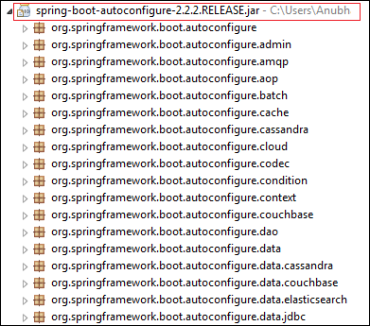
Cont…

Slide 87
Need of auto-configuration
Spring-based application requires a lot of configuration. When we use Spring MVC, we need to configure dispatcher servlet, view resolver, web jars among other things. The following code shows typical configuration of a dispatcher servlet in a web application:
<servlet>
<servlet-name>dispatcher</servlet-name>
<servlet-class>
org.springframework.web.servlet.DispatcherServlet
</servlet-class>
<init-param>
<param-name>contextConfigLocation</param-name>
<param-value>/WEB-INF/todo-servlet.xml</param-value>
</init-param>
<load-on-startup>1</load-on-startup>
</servlet>
<servlet-mapping>
<servlet-name>dispatcher</servlet-name>
<url-pattern>/</url-pattern>
</servlet-mapping>

Slide 88
Configuring datasource:
<bean id="dataSource" class="com.mchange.v2.c3p0.ComboPooledDataSource"
destroy-method="close">
<property name="driverClass" value="${db.driver}" />
<property name="jdbcUrl" value="${db.url}" />
<property name="user" value="${db.username}" />
<property name="password" value="${db.password}" />
</bean>
<jdbc:initialize-database data-source="dataSource">
<jdbc:script location="classpath:config/schema.sql" />
<jdbc:script location="classpath:config/data.sql" />
</jdbc:initialize-database>

Slide 89
Configuring entity manager factory
<bean
class="org.springframework.orm.jpa.LocalContainerEntityManagerFactoryBean"
id="entityManagerFactory">
<property name="persistenceUnitName" value="hsql_pu" />
<property name="dataSource" ref="dataSource" />
</bean>

Slide 90
Configuration Transaction Manager
<bean id="transactionManager" class="org.springframework.orm.jpa.JpaTransactionManager">
<property name="entityManagerFactory" ref="entityManagerFactory" />
<property name="dataSource" ref="dataSource" />
</bean>
<tx:annotation-driven transaction-manager="transactionManager"/>

Slide 91
Daily Quiz - MCQ
34. Which Spring annotation is used to handle Cross-Origin Resource Sharing (CORS) in Spring MVC?
a) @CrossOrigin
b) @CORSHandler
c) @EnableCORS
d) @CORSConfig
Answer:
a) @CrossOrigin
Explanation:
The @CrossOrigin annotation is used in Spring MVC to handle Cross-Origin Resource Sharing (CORS).

Slide 92
Daily Quiz - MCQ
35. Which Spring Boot Starter would you use for developing web applications?
a) spring-boot-starter-web
b) spring-boot-starter-jdbc
c) spring-boot-starter-data
d) spring-boot-starter-app
Answer:
a) spring-boot-starter-web
Explanation:
spring-boot-starter-web is used for building web, including RESTful, applications using Spring MVC.

Slide 93
Daily Quiz - MCQ
36. In which layer is Spring MVC used?
a) Data layer
b) Business layer
c) Presentation layer
d) Integration layer
Answer:
c) Presentation layer
Explanation:
Spring MVC is used in the presentation layer to handle web requests and construct responses.

Slide 94
Spring Data JPA
What is JPA?
Spring Boot JPA is a Java specification for managing relational data in Java applications. It allows us to access and persist data between Java object/ class and relational database. JPA follows Object-Relation Mapping (ORM). It is a set of interfaces. It also provides a runtime EntityManager API for processing queries and transactions on the objects against the database. It uses a platform-independent object-oriented query language JPQL (Java Persistent Query Language).
In the context of persistence, it covers three areas:
The Java Persistence API
Object-Relational metadata
The API itself, defined in the persistence package.
JPA is not a framework. It defines a concept that can be implemented by any framework.

Slide 95
Why should we use JPA?
JPA is simpler, cleaner, and less labor-intensive than JDBC, SQL, and hand-written mapping. JPA is suitable for non-performance oriented complex applications. The main advantage of JPA over JDBC is that, in JPA, data is represented by objects and classes while in JDBC data is represented by tables and records. It uses POJO to represent persistent data that simplifies database programming.

Slide 96
Why should we use JPA?
JPA is simpler, cleaner, and less labor-intensive than JDBC, SQL, and hand-written mapping. JPA is suitable for non-performance oriented complex applications. The main advantage of JPA over JDBC is that, in JPA, data is represented by objects and classes while in JDBC data is represented by tables and records. It uses POJO to represent persistent data that simplifies database programming.

Slide 97
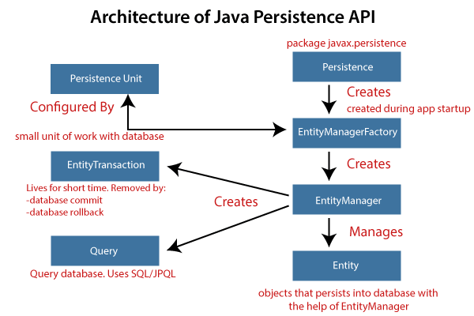
Architecture Of JPA

Slide 98
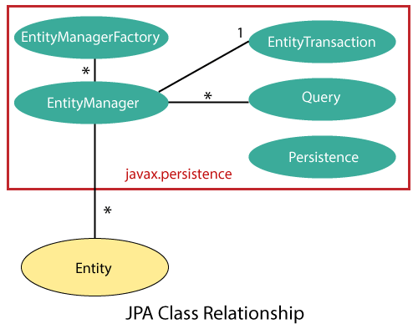
JPA Class Relationships

Slide 99
JPA Implementations
JPA is an open-source API. There is various enterprises vendor such as Eclipse, RedHat, Oracle, etc. that provides new products by adding the JPA in them. There are some popular JPA implementations frameworks such as Hibernate, EclipseLink, DataNucleus, etc. It is also known as Object-Relation Mapping (ORM) tool.

Slide 100
Daily Quiz - MCQ
1. JPA stands for ____?
Java persistence API
Java programming API
Java persistence Arguments
Answer: A) Java persistence API
Explanation:
JPA stands for Java persistence API.
2. JPA is used for ____?
For data access, persistence, and management in Java applications
For testing java applications
For creating runtime API
All of the above
Answer: A) For data access, persistence, and management in Java applications
Explanation:
JPA is used for data access, persistence, and management in Java applications.

Slide 101
Daily Quiz - MCQ
3. A database table is represented by an ____, which is a Java class.
Persistence
Entity
Primary key
Relationships
Answer: B) Entity
Explanation:
A database table is represented by an entity, which is a Java class.

Slide 102
Daily Quiz - MCQ
4. ____ is a class that allows you to persist, update, and delete entities.
Persistence
Entity
EntityManager
Bias
Answer: C) EntityManager
Explanation:
EntityManager is a class that allows you to persist, update, and delete entities.

Slide 103
Daily Quiz - MCQ
5. Which of the following is an entity's unique identifier?
A. Transactions
B. Entity
C. Primary key
D. Relationships
Answer: C) Primary key
Explanation:
A primary key is an entity's unique identifier.
6. Is JPA an open-source API?
A. Yes
B. No
Answer: A) Yes
Explanation:
Yes, JPA is an open-source API.

Slide 104
Daily Quiz - MCQ
7. In a relationship mapping, which of the following annotations is used to indicate the join column?
@Join
@Column
@JoinColumn
All of the above
Answer: C) @JoinColumn
Explanation:
@JoinColumn annotation is used to specify the join column in relationship mapping.
8. ____ annotation is used to specify a Query by providing a static name?
@list
@NamedQuery
@NamedQueries
@querieslist
Answer: B) @NamedQuery
Explanation:
@NamedQuery annotation is used to specify a Query by providing a static name.

Slide 105
Daily Quiz - MCQ
9. Which of the following annotations is used to define a list of named queries?
@list
@NamedQuery
@NamedQueries
@querieslist
Answer: C) @NamedQueries
Explanation:
@NamedQueries annotation is used for specifying the list of named queries.
10. Which of the following annotations is used to indicate an entity's primary key field?
@pk
@primary
@key
@id
Answer: D) @id
Explanation:
@id annotation is used to specify the primary key field of an entity.

Slide 106
Daily Quiz - MCQ
11. ____ is a programming capability that allows data to be converted from object type to relational type and vice versa.
A. ORM
B. JPA
C. JRE
D. Java RMI
Answer: A) ORM
Explanation:
ORM is a programming capability that allows data to be converted from object type to relational type and vice versa.
12. Which of the following annotations defines a class as an entity?
A. @table
B. @entitymanager
C. @entityfactory
D. @entity
Answer: D) @entity
Explanation:
@entity annotation is used to define a class as an entity.

Slide 107
Old Question Papers
https://www.vturesource.com/vtu/3704942925/Advanced-JAVA-and-J2EE/15CS553/Feb-2021

Slide 108
Expected Questions
What is Spring?
What are the advantages of spring framework?
What are the modules of spring framework?
What is IOC and DI?
What is the front controller class of Spring MVC?
What does @Controller annotation?
What does @RequestMapping annotation?
Does spring MVC provide validation support?

Slide 109
Weekly Assignment-1
What does an additional configuration file contain in Spring MVC application?
What is an InternalResourceViewResolver in Spring MVC?
How to declare a class as a controller class in Spring MVC?
How to map controller class and its methods with URL?
What is the purpose of @PathVariable annotation in Spring MVC?

Slide 110
Weekly Assignment-2
What is the role of @ResponseBody annotation in Spring MVC?
What is the role of the Model interface in Spring MVC?
What do you mean by ModelAndView in Spring MVC?
What is ModelMap in Spring MVC?
What are the ways of reading data from the form in Spring MVC?
What is Spring MVC form tag library?
What do you understand by validations in Spring MVC?
What is Bean Validation API?

Slide 111
Weekly Assignment-3
What is the use of @Valid annotation in Spring MVC?
What is the purpose of BindingResult in Spring MVC validations?
How to validate user's input within a number range in Spring MVC?
How to validate the user input in a particular sequence in Spring MVC?
What is the purpose of custom validations in Spring MVC?
What do you understand by Spring MVC Tiles?

Slide 112
Weekly Assignment-4
How to create Spring Boot project using boot CLI?
How to create simple Spring Boot application?
What are the Spring Boot Annotations?
What is Spring Boot dependency management?
What are the Spring Boot properties?

Slide 113
Weekly Assignment-5
What are the Spring Boot Starters?
What is Spring Boot Actuator?
What is thymeleaf?
How to use thymeleaf?
How to connect Spring Boot to the database using JPA?

Slide 114
Weekly Assignment-6
How to connect Spring Boot application to database using JDBC?
What is @RestController annotation in Spring Boot?
What is @RequestMapping annotation in Spring Boot?
How to create Spring Boot application using Spring Starter Project Wizard?
) Explain Spring Vs Spring Boot?

Slide 115
Daily Quiz
What is MVC?
What is Spring MVC?
What is the front controller of Spring MVC?
Explain the flow of Spring MVC?
What are the advantages of Spring MVC Framework?

Slide 116
Daily Quiz
What is Spring Boot?
What are the advantages of Spring Boot?
What are the features of Spring Boot?
How to create Spring Boot application using Maven?
How to create Spring Boot project using Spring Initializer?

Slide 117
Recap of Unit
Threads allows a program to operate more efficiently by doing multiple things at the same time.
User threads are threads which are created by the application or user.
Daemon threads are threads which are mostly created by the JVM.
Java brings various Streams with its I/O package that helps the user to perform all the input-output operations.
Thread Lifecycle.
Annotations are used to provide supplement information about a program.

Slide 118
Thank You

